Slide 1
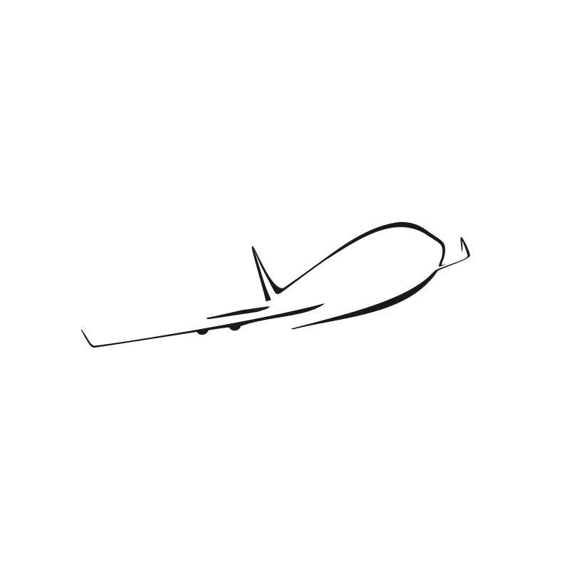
CSC380 – Airplane Application
Andrew Spano, Jimmy Nguyen, Zachary Gudlin

Slide 2
Team Members Andrew Spano Jimmy Nguyen Zak Gudlin
Project Stats:
Zachary Gudlin:
insertions: 7464 (36%)
deletions: 3081 (29%)
files: 488 (32%)
commits: 194 (33%)
lines changed: 10545
first commit: Mon Feb 5 16:36:02 2018 -0500
last commit: Thu May 3 14:54:22 2018 -0400
Andrew Spano:
insertions: 3052 (15%)
deletions: 1498 (14%)
files: 191 (13%)
commits: 211 (37%)
lines changed: 4550
first commit: Thu Feb 1 14:24:42 2018 -0500
last commit: Thu May 3 13:40:09 2018 -0400
Jimmy Nguyen:
insertions: 9951 (49%)
deletions: 6058 (57%)
files: 835 (55%)
commits: 173 (30%)
lines changed: 22434
first commit: Mon Feb 5 23:11:17 2018 -0500
last commit: Thu May 3 15:08:08 2018 -0400
total:
insertions: 20467 (100%)
deletions: 10637 (100%)
files: 1514 (100%)
commits: 483 (100%)

Slide 3
Project Description
This application consists of three parts.
Part 1 is administrative controls. A system administrator can set up a plane, airport, flight, and accounts for users to book flights under.
Part 2 allows users to book/manage their flights with the option to book flights with baggage plans (at additional costs).
Part 3 allows users to rent a vehicle nearby their destination airport.

Slide 4
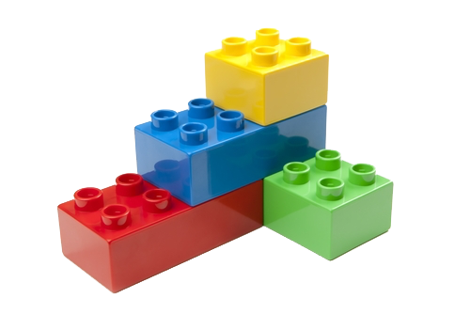
Modular Code Base [ Launcher, MenuBar, GuiApplication]
GuiApplication is an interface for creating windows.
MenuBar is a standalone addition to our main stage. It only appears after login and can be added/removed easily.
BorderPane.setCenter() was used to dynamically change content on our existing main stage.
Implementing modular code base that can be easily added/removed without affecting other functionality.

Slide 5
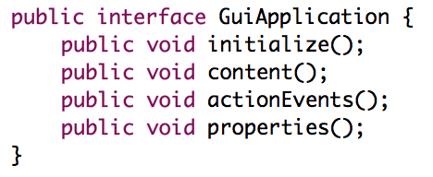
GUI Application
Ensures that every window is organized and has all its dependencies.
Every window was set with BorderPane.setCenter(); so our stage was dynamically changing content.
GuiApplication is an interface that requires implementation to create a new window view. It was only dependent on itself.

Slide 6

Static Methodology [ APZState, AdminState, FilePath]
APZState would save our user information.
AdminState saved software configured files for user usage.
File Path would save paths to files via String.
Implementing static methods and variables that can be accessed multiple times without creating objs

Slide 7
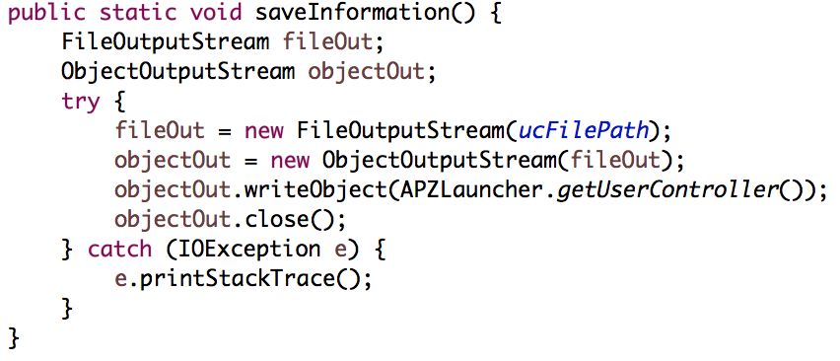
APZState
If a save state had to be called, it would be done so via APZState.saveInformation(); which would execute a binary write.
APZState had static methods to save and load in files.

Slide 8
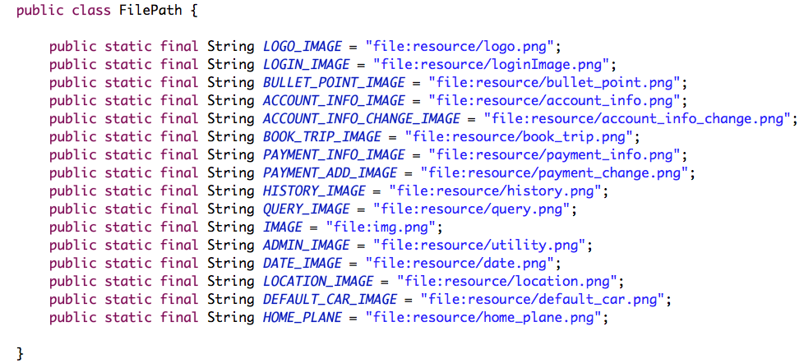
File Path
GuiApplication is an interface that requires your implementation to create a new window view.
FilePath for example was used to set the path for assets as opposed to being hard coded.
Ex. new Image(FilePath.LOGO_IMAGE);

Slide 9
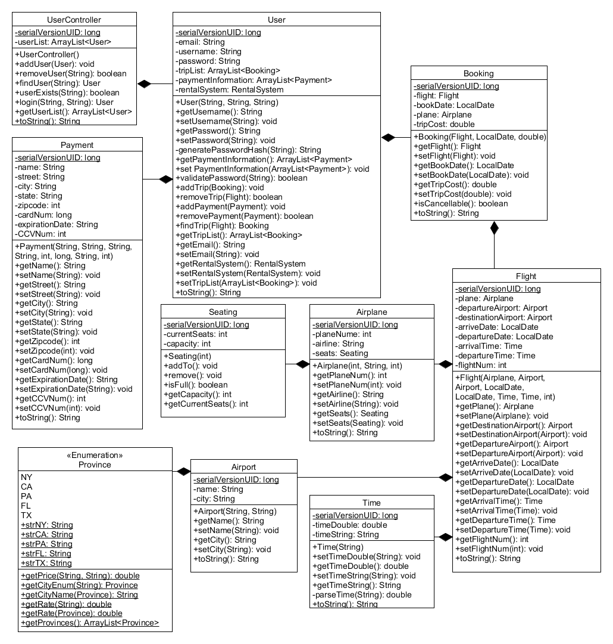
UML Class Diagram
Our program uses a lot of composition. It all starts from UserController.
Our controller has a list of users. Each user has a list of flights they booked. Each flight has a plane and airport.
This creates a tree-like composition.

Slide 10
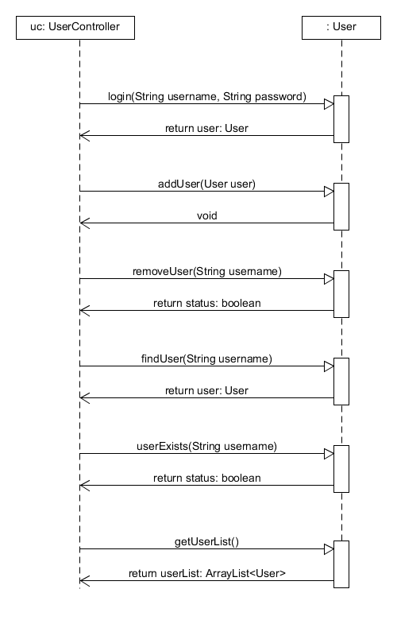
UML Sequence Diagram
This is a diagram of how UserController interacts with User.
As previously discussed, UserController is our main model controller to access all data.

